Slide 1
Fancy style for PULP presentations (v1.1 – 03.2020)
Author <email@iis.ee.ethz.ch)

Slide 2
The slide is 16:9 format and is 32cm x 18cm
You can use shape properties to enter sizes of boxes and images so that they align properly
14.5 cm
28 cm
32 cm

Slide 3
You can change the logo under View → Master
Leave it empty if you do not have an additional logo

Slide 4
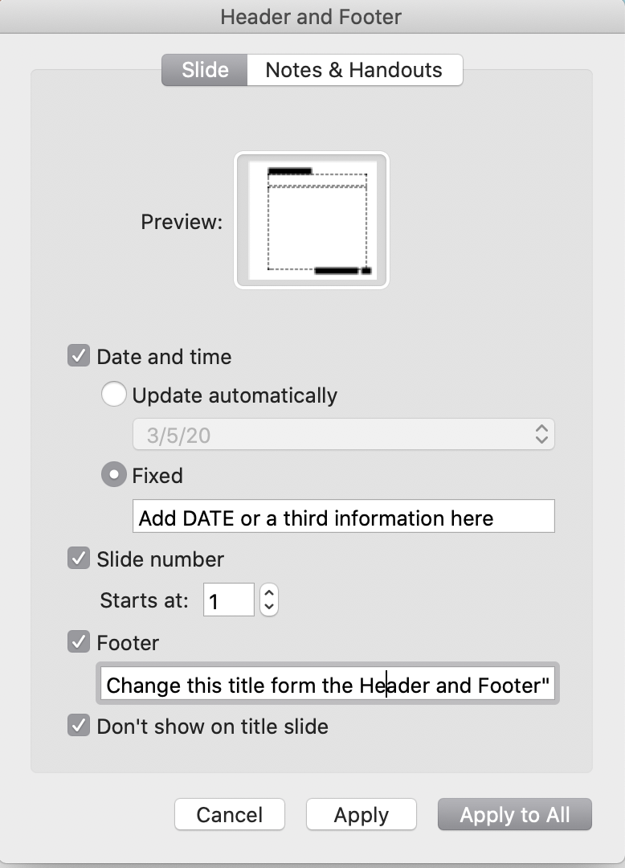
Please adapt the headers/footers
Use the “Header/Footer” to change
  Footer: That will be on the top left
  Date will show on the bottom right
  Page number will show on the extreme right

Slide 5
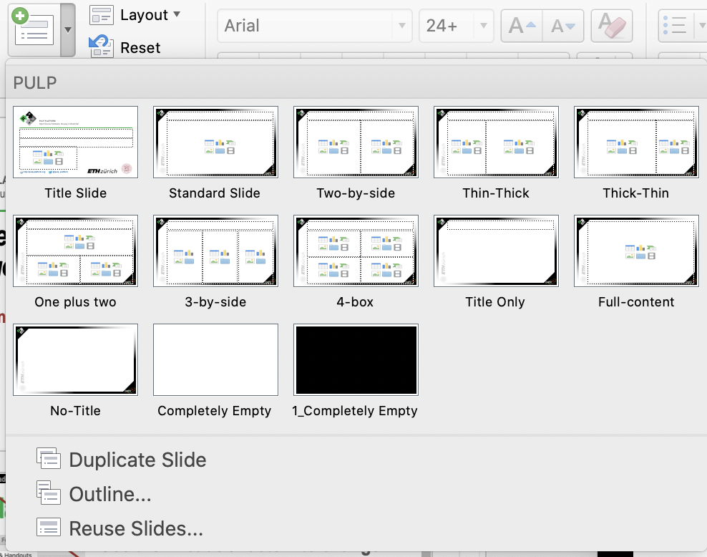
Use the standard templates as much as possible
There are several default page styles.
  If you copy from other presentations, in most cases it will add new styles. If possible, change it to the existing styles (The title only is very flexible), which makes life easy

Slide 6
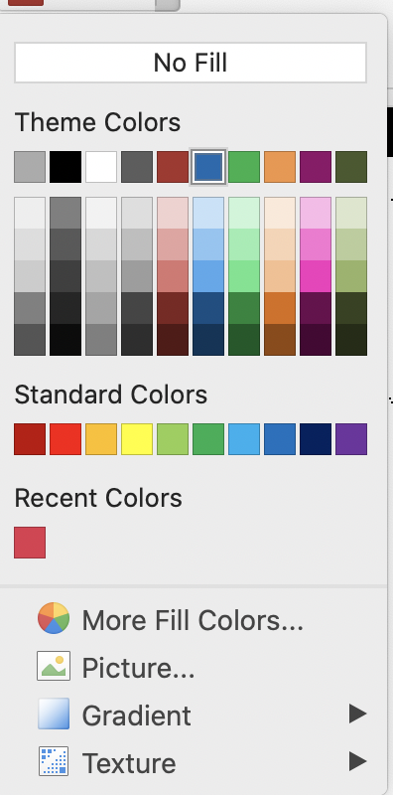
Try using theme colors at the top
If we make slight modifications to colors (i.e. to help color blind people) your slides will automatically get adjusted.
  This is generally good, also helps with consistency
  Problem is when the template colors differ significantly between different presentations, then using absolute colors creates less confusion
  I suggest sticking to the template colors.

Slide 7
Our standard colors for drawing
All are template colors
No outlines necessary
Standard boxes should allow you to add text
  Default is not to autofit
Processing Cores
Memory Elements
Interconnect
Accelerators
Peripherals

